Slide 1
Instagram User Analytics

Slide 2

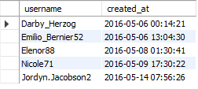
Task: Identify the five oldest users on Instagram from the provided database.
MySQL Query in
Action
Query Result

Slide 3

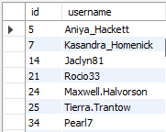
Task: Identify users who have never posted a single photo on Instagram.
MySQL Query in
Action
Query Result

Slide 4
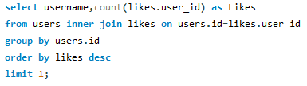

Task: Determine the winner of the contest and provide their details to the team.
MySQL Query in
Action
Query Result

Slide 5
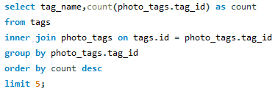
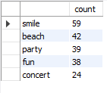
Task: Identify and suggest the top five most commonly used hashtags on the platform.
MySQL Query in
Action
Query Result

Slide 6
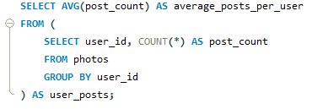

Task: Calculate the average number of posts per user on Instagram
MySQL Query in
Action
Query Result

Slide 7


Task: Provide the total number of photos on Instagram divided by the total number of users.
MySQL Query in
Action
Query Result

Slide 8
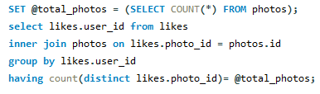

Task: Identify users (potential bots) who have liked every single photo on the
site, as this is not typically possible for a normal user.
MySQL Query in
Action
Query Result

